Slide 1








ConOps for IMMoRTALS Challenge Problems, Solutions, Technologies & Technical Approaches
BBN Technologies
Work done under the DARPA BRASS Program
IMMoRTALS TEAM Sensitive
Notes:
Some of the dimensions that the warfighter considers when they build their own mission specific operational picture.

Slide 2
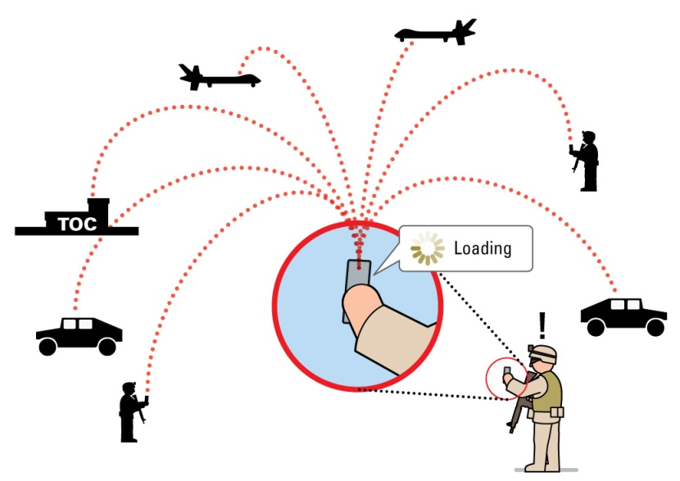
Summary of IMMoRTALS Goals
Tactical Situation Awareness (SA) is a key part of modern warfare, law enforcement, humanitarian missions, etc.
SA is characterized by
Diverse and changing use cases and requirements
Many and changing operating environments
Long lifecycle in a fast evolving ecosystem
IMMoRTALS will develop, demonstrate and evaluate technology to make software evolve in this context

Slide 3
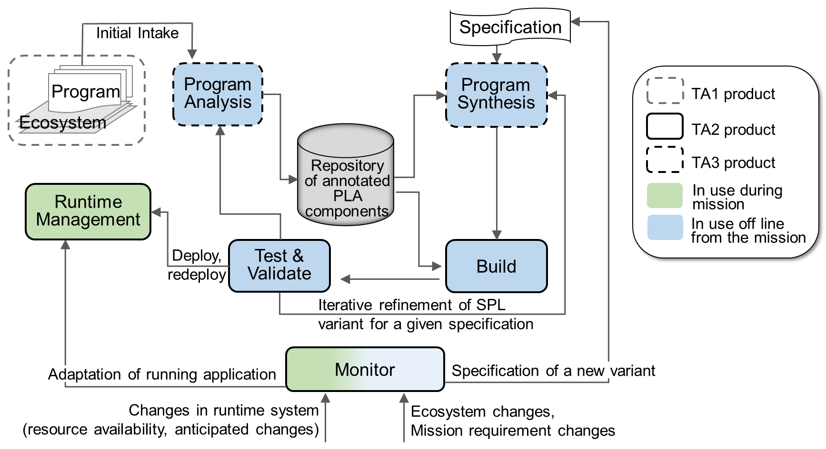
Overview of IMMoRTALS Approach
Notes:
Important to point out the synthesis part of this. It’s not just about changing runtime parameters, it includes analysis of program components, synthesis for creating variants, and

Slide 4

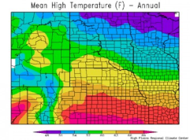
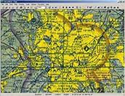
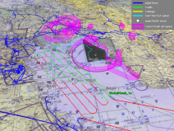
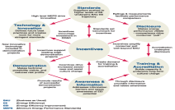
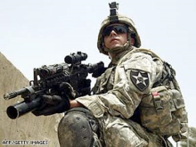
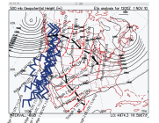
Dimensions of Mission-Specific Tactical Situation Awareness*
Climate
Visibility, rain, wind
Temperature
Current & future
Mission
ISR
Search and Rescue
Supply
Policy
Organization policies
Operating procedures
Rules of engagement
Mission plans
Location
Geo coordinates
Terrain/buildings (images)
Surrounding
No contact, taking fire
Red/blue forces
Risk Estimated Distance
Equipment
Battery & load
Fuel
Ammunition
Movement
Tracks
Planned/observed routes
Velocity
*Adapted from Cognitive Radio Architecture Evolution, Mitola, IEEE, 2009
SA applications running on mobile environments include, control, and are affected by these dimensions. Any ecosystem change that affects these can potentially break the SA apps.
Notes:
Some of the dimensions that the warfighter considers when they build their own mission specific operational picture.
Note that we are not saying that we are covering changes like I want this location as opposed to that. We are saying that location (coordinates and images of terrain/buildings) are so important in the tactical SA domain that any changes in mission, hardware, software, etc. will likely cross paths with code that handles location. A new device may come with a new sensor (camera, IR camera, new GPS receiver), a new library may treat location differently etc. It is true that location/images of surroundings is not the only SA data--but our pared down ATAK client does not currently handle anything else. So, we can also say location/images is a factor like you say below, and claim that if we can handle this, other data types can be handled similarly.

Slide 5
Dimensions of Mission-Specific Tactical Situation Awareness*
Climate
Visibility, rain, wind
Temperature
Current & future
Mission
ISR
Search and Rescue
Supply
Policy
Organization policies
Operating procedures
Rules of engagement
Mission plans
Location
Geo coordinates
Terrain/buildings (images)
Surrounding
No contact, taking fire
Red/blue forces
Risk Estimated Distance
Location is Central to Tactical SA
Equipment
Battery & load
Fuel
Ammunition
Movement
Tracks
Planned/observed routes
Velocity
*Adapted from Cognitive Radio Architecture Evolution, Mitola, IEEE, 2009
As an example that is generalizable to other dimensions, location is a core tactical SA attribute that ecosystem changes are likely to affect over the life of the SA application.
Notes:
Some of the dimensions that the warfighter considers when they build their own mission specific operational picture.
Note that we are not saying that we are covering changes like I want this location as opposed to that. We are saying that location (coordinates and images of terrain/buildings) are so important in the tactical SA domain that any changes in mission, hardware, software, etc. will likely cross paths with code that handles location. A new device may come with a new sensor (camera, IR camera, new GPS receiver), a new library may treat location differently etc. It is true that location/images of surroundings is not the only SA data, but it is a critical factor/dimension. Techniques that can handle ecosystem changes that affect location should be generalizable to other dimensions.

Slide 6
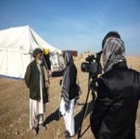
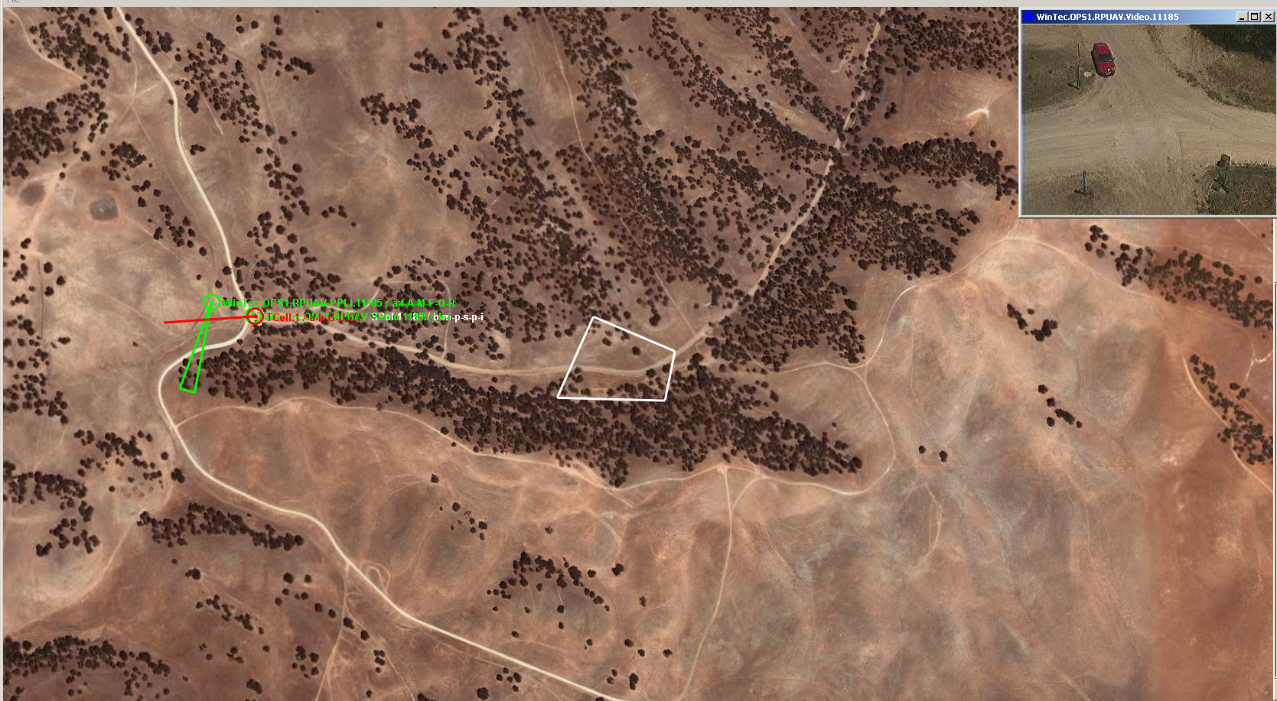


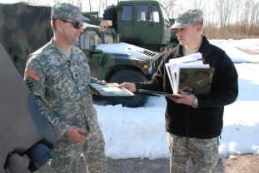

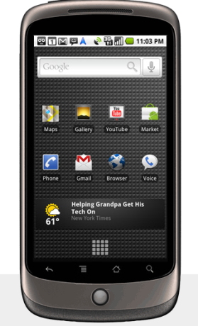
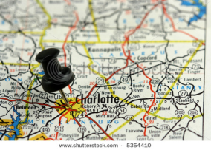
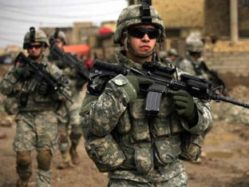
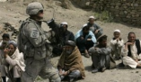


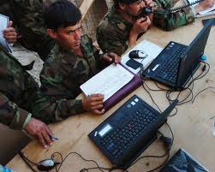
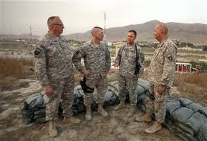


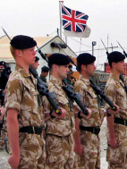
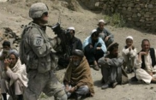
ConOps: “Boots-on-the-ground” – Mission Activities at the Tactical Edge
Mission Planning
Identify Data Sources & Hardware/Software Assets Available
Receive Mission Assignment
Share & filter information as required by mission needs & context
Analyze & report completed mission
Tailor & use mission-specific operational picture
Mission Analysis
Mission Execution
Tactical SA ConOps is to create, process, & share SA information at tactical edge.
IMMoRTALS ConOps is to update, evolve, and synthesize SA app software for continued operation during ecosystem changes throughout a long lifecycle.
Notes:
Highlevel overview of where our problem fits in the big picture.

Slide 7
ConOps: Motivations for Software & Resource Adaptation & Evolution
Mission Planning
Number/diversity of sources, volume of and security classification of data, hardware/software capabilities to choose from are increasing rapidly
Missions are increasingly variable (sanctions, counter-drug, terrorism, insurgency, humanitarian assistance, …)
Software supporting warfighter must adapt and evolve to function despite dynamic changes in mission focus, data sources, network availability, and environmental conditions
Warfighters must be able to analyze solutions & improve them throughout the lifecycle
Warfighters must have confidence to use & share software changes in mission-critical contexts
Mission Analysis
Mission Execution
Mission support applications must adapt and evolve reliably and efficiently to
accommodate these dynamic factors and changes
Notes:
Highlevel overview of where our problem fits in the big picture.

Slide 8
Software Transformations to Respond to Change Drivers
Change Drivers
Transformations
Mission Requirements
Number of nodes
Roles of participants
Interoperability
Include/Exclude data
Substitution
Addition
Deployment environment
Hardware
Operating system
Network
Third-party libraries
Removal
Change drivers can affect what is available in the target environment or functionality that the mission
needs; Transformations consist of three basic types of software modifications.

Slide 9
Two Flavors of Program Transformation in IMMoRTALS
Baseline
New mission
requirement
New target
environment
Library Update
HW Update
time
Offline, pre-deployment adaptation
…
In response to changes, the baseline application evolves – resulting in program variants that have different source code and binary. This adaptation happens offline, i.e., the new binary needs to be deployed to take advantage of the transformation. The changes in code include substitution, addition, and removal of code elements.
Changes in the
operating
environment
Online, runtime adaptation
Or
Or
behavior
instrumentation
In response to changes, the deployed application adapts its behavior or transforms its binary to preserve the behavior or adapts both its binary and behavior – the deployed binary is modified (may involve synthesizing and/or downloading patches). This adaptation happens online, i.e., when the application is used in mission, no new variant with different source or binary is synthesized. Needs additional instrumentation to be present in the deployed binary (the black oval )

Slide 10


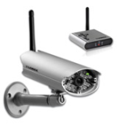
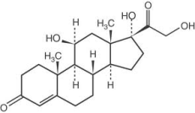
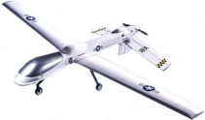
Example Mission, Supporting Data Sources, & Hardware/Software Assets
Mission: Extract NGO aid workers who are being threatened by insurgents in a village.
Historical Databases
Tasks in Achieving Mission Goals
Data Sources & Assets
Identify friends & relevant info (e.g., visual id, languages)
Understand prior interactions with friends & leaders
Locate/track friends, enemies, & victims
Find layouts of streets, landmarks
Identify potentially “safe” & “unsafe” locations
Annotated text, pictures, video, geo-location data
Plan safe, alternative, ingress & egress routes
UAV video feed, sensor information, handsets, location data
Communicate with nearby units, base stations
Reachback to command centers, support (air/naval)

Slide 11
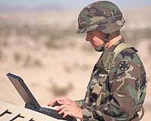
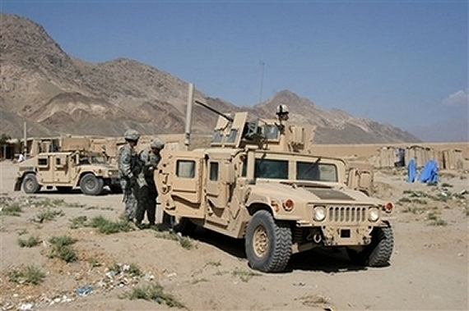
Example Mission, Supporting Data Sources, & Hardware/Software Assets
Mission: Extract NGO aid workers who are being threatened by insurgents in a village.
Historical Databases
Tasks in Achieving Mission Goals
Data Sources & Assets
Identify friends & relevant info (e.g., visual id, languages)
Understand prior interactions with friends & leaders
Locate/track friends, enemies, & victims
Find layouts of streets, landmarks
Identify potentially “safe” & “unsafe” locations
Annotated text, pictures, video, geo-location data
Plan safe, alternative, ingress & egress routes
UAV video feed, sensor information, handsets, location data
Current SA application works with handhelds coordinated with a server over IP and assumes unobstructed GPS
Communicate with nearby units, base stations
Task 1
Task 2
Problem: What if the mission is set in a canopied jungle, or the adversary has the ability to spoof GPS?
Problem: What if the mission is set in a network challenged environment, and has a large number of participants?

Slide 12
Mapping Sample Mission into Phase 1 Challenge Problems
Challenge problem 1: Location provider
Variations in environment:
Desert: GPS is available
Jungle under canopy: GPS unavailable (foliage block radio signals)
Indoors: GPS unavailable
Variations in mission requirements:
Any location where adversarial GPS-spoofing is expected: trusted GPS required
Challenge problem 2: bandwidth
Number of clients
Network capacity (various mesh networks vs. cellular 3G vs. 4G)

Slide 13





Task 1: Offline transformation in response to mission requirement changes
Problem 1: New mission requires location information that can be trusted. Baseline application uses a location provider that is commercial grade. Components that provide more accurate and authenticated location information can be found. How to transform the baseline code to work with trusted location provider?
: Commercial Grade
: Accuracy <Low>
: Untrusted
Change request:
Mission needs
Accurate and
trusted location
: Military Grade
: Accuracy <High>
: Trusted
: Commercial Grade
: Accuracy <High>
Rest of the Program
Location Provider
Available components (analyzed, modeled)
Current application
Shapes do not imply exact signature match: some code massaging may still be needed to compile and run
Notes:
What is the right user interface that can support this capability?
During what phases of the mission can these capabilities be used?
How do we evaluate the usability of this capability?

Slide 14


Task 1: Substitute and Massage the Code
Solution: Represent relevant semantics of the location providers and the use of location provider in the application. Infer resource dependency and resource usage of location providers and augment the models. Identify candidate location providers that offer the desired properties. Substitute the existing location provider, managing any differences in signature (the function names and argument order may be different) and functional dependencies (initialization, imports, etc). Evaluate resource usage, build and test.
Rest of the Program
Mutated application
Location Provider
Filter by “friends”
Filter by Location
Available components (analyzed, modeled)
Notes:
Warfighter & Mission Context
who
what
when
why

Slide 15

Task 2: Offline transformation to mission requirement and target environment change
Problem 2: New mission is in a bandwidth restricted environment. The new mission handles the same SA data as the baseline (images), but has a different number of clients publishing at a different rate from the baseline (which was 1 publisher and 1 subscriber). How to transform the baseline so that the new variant provides acceptable performance?
Bandwidth footprint
Change request:
Message frequency
Available bandwidth
Image Producer
Image transformers
Current application
Other image producers
Notes:
What is the right user interface that can support this capability?
During what phases of the mission can these capabilities be used?
How do we evaluate the usability of this capability?

Slide 16
Task 2: Synthesize and add code that relieves the pressure on bandwidth
Solution: As before, semantic and resource specification is in the model space. Resource DSL type checking reveals that with the mission parameters (number of clients, publication size, and frequency), the bandwidth requirement will exceed what is available. Further analyses of the models reveal:
The function that sends SA data uses bandwidth and the amount of data put on the network is correlated to the SA data being sent
Code exists that compresses objects or transforms images
Compose compression or image transformation with SA data, and massage code to address syntax and functional dependency. Re-evaluate resource usage, build and test as before
: Size of image produced
→
: Scale factor
New bandwidth footprint
Synthesized Image Producer composing compression / transformation
Transformed application
: Size of image produced
Code Substitution
Notes:
Warfighter & Mission Context
who
what
when
why

